Slide 1
Facial Age Estimation
Insomnia team

Slide 2
Facial Age Estimation
Unit 1. Introduction
Unit 3. Results
1.1. Background Information
1.2. Motivation and Objective
1.3. Members and Role Assignments
1.4. Schedule and Milestones
3.1. Data Preprocessing
3.2. Exploratory Data Analysis (EDA)
3.3. Modeling
3.4. User Interface
3.5. Testing and Improvements
Unit 2. Project Execution
Unit 4. Projected Impact
2.1. Data Acquisition
2.2. Training Methodology
2.3. Workflow
2.1. System Design
4.1. Accomplishments and Benefits
4.2. Future Improvements

Slide 3
Facial Age Estimation
Unit 1. Introduction
1.1. Background Information
1.2. Motivation and Objective
1.3. Members and Role Assignments
1.4. Schedule and Milestones

Slide 4
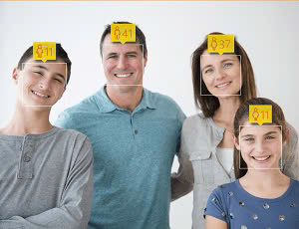
Age prediction based on facial recognition
1.1
Background Information
UNIT
01
Age prediction using facial recognition allows estimating an individual's age by analyzing facial features from images or videos.
Facial Age Estimation

Slide 5




1.2
Motivation and Objective
UNIT
01
Real-world applications of facial recognition, especially in age prediction, and why age prediction is important.
Facial Age Estimation

Slide 6
1.3
Members and Role Assignments
UNIT
01
Trịnh Minh Hiếu: Team Leader
​Nguyễn Mạnh Khang: Team Member
​Nguyễn Kiên An: Team Member
​Nguyễn Thái Bình: Team Member
​Hà Tấn Hiệp: Team Member
​Nguyễn Vân Anh: Team Member
Facial Age Estimation

Slide 7
1.4
Schedule and Milestones
UNIT
01
Data Acquisition: Start Date: 7/14/2024 – End Date: 7/23/2024
1.1. Data Selection
1.2. Data Visualization
1.3. Data Preprocessing
Design Model: Start Date: 7/23/2024 – End Date: 7/30/2024
2.1. Choose and Research the CNN architecture
2.2. Implement in code
Training Model: Start Date: 7/24/2024 – End Date: 8/14/2024
3.1. Implement in code
3.2. Tuning Hyperparameter
3.3. Training and Validation
Testing and improvement: Start Date: 8/1/2024 – End Date: 8/14/2024
4.1. Adjusting the Hyperparameter
4.2. Training again
4.3. Comparing results
Creating User Interface: Start Date: 8/2/2024 – End Date: 8/14/2024
Writing Report: Start Date: 7/30/2024 – End Date: 8/14/2024
Facial Age Estimation

Slide 8
Facial Age Estimation
Unit 2. Project Execution
2.1. Data Acquisition
2.2. Training Methodology
2.3. Workflow
2.4. System Diagram

Slide 9
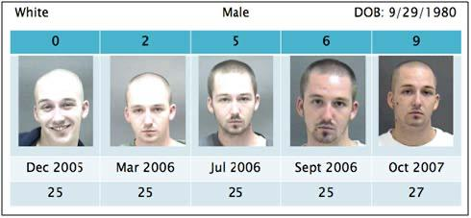
Morph
2.1
Data Execution
UNIT
02
MORPH is a facial age estimation dataset, which contains 55,134 facial images of 13,617 subjects ranging from 16 to 77 years old
Facial Age Estimation

Slide 10
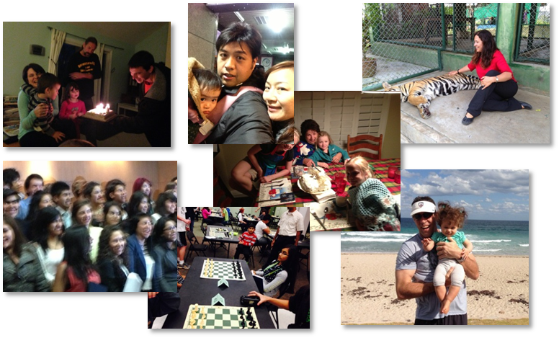

Adience
2.1
Data Acquisition
UNIT
02
The Adience dataset, published in 2014, contains 26,580 photos across 2,284 subjects with a binary gender label and one label from eight different age groups, partitioned into five splits
The key principle of the data set is to capture the images as close to real world conditions as possible, including all variations in appearance, pose, lighting condition and image quality, to name a few.
Facial Age Estimation

Slide 11
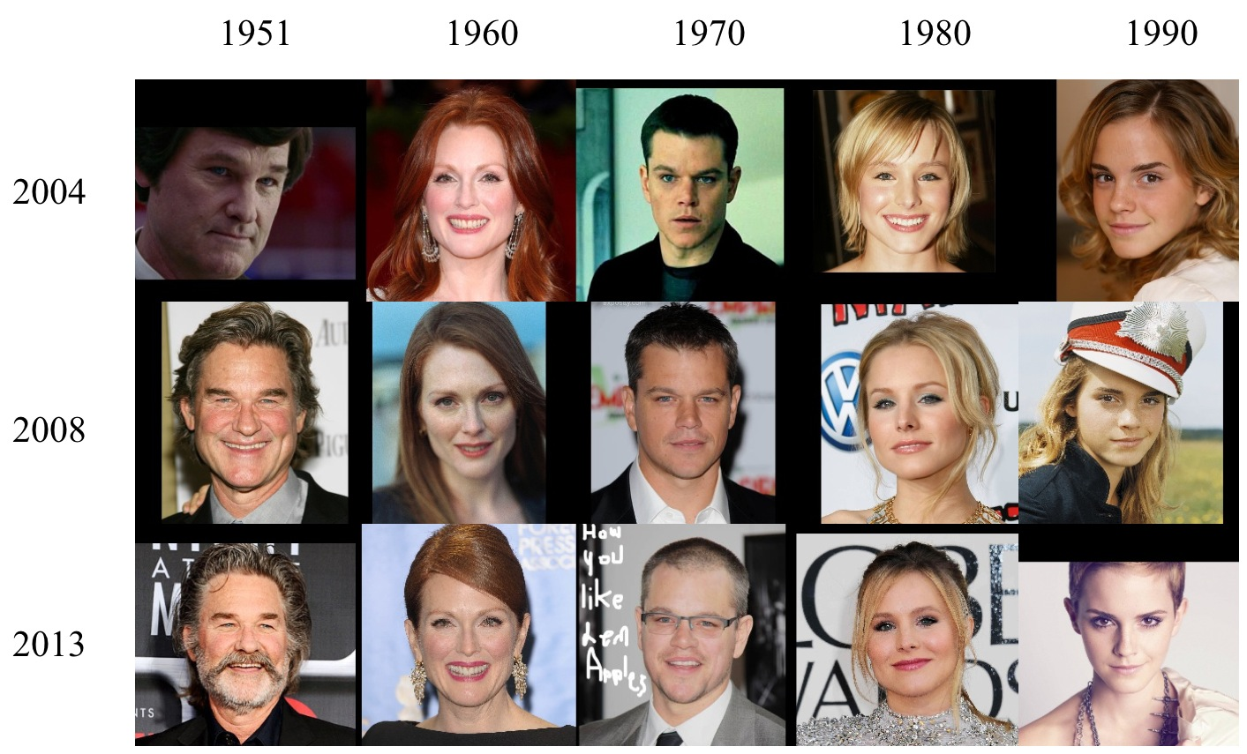
CACD
2.1
Data Acquisition
UNIT
02
The Cross-Age Celebrity Dataset (CACD) contains 163,446 images from 2,000 celebrities collected from the Internet. The images are collected from search engines using celebrity name and year (2004-2013) as keywords
Facial Age Estimation

Slide 12
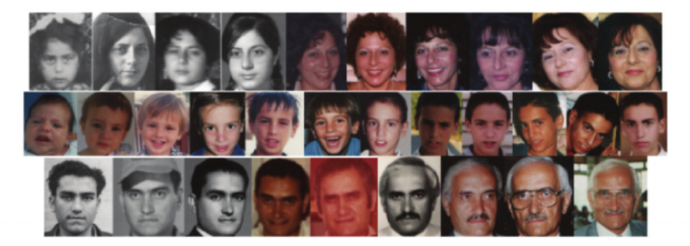
FG-Net
2.1
Data Acquisition
UNIT
02
FG-Net is a dataset for age estimation and face recognition across ages. It is composed of a total of 1,002 images of 82 people with age range from 0 to 69 and an age gap up to 45 years
Facial Age Estimation

Slide 13
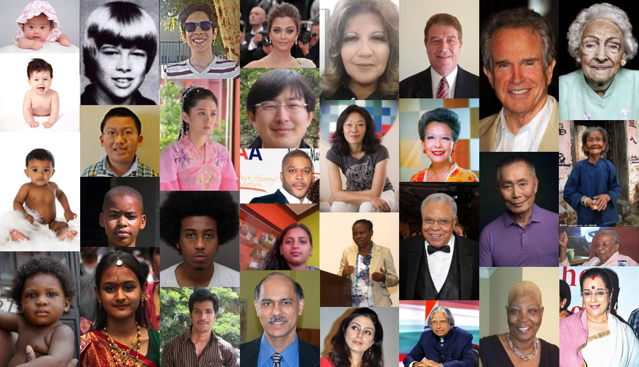
UTKFace
2.1
Data Acquisition
UNIT
02
Highlights
Consists of 20k+ face image in the wild
Provides the correspondingly aligned and cropped faces
Provides the corresponding landmark ( 68 points )
Images are labelled by age, gender, and ethnicity
Labels – [age]_[gender]_[race]_[date&time].jpg
[age] is an integer from 0 to 116, indicating the age
[gender] is either 0 (male) or 1 (female)
[race] is an integer from 0 to 4, denoting White, Black, Asian, Indian, and Others (like Hispanic, Latino, Middle Eastern)
[date&time] showing the date and time an image was collected to UTKFace
Facial Age Estimation

Slide 14
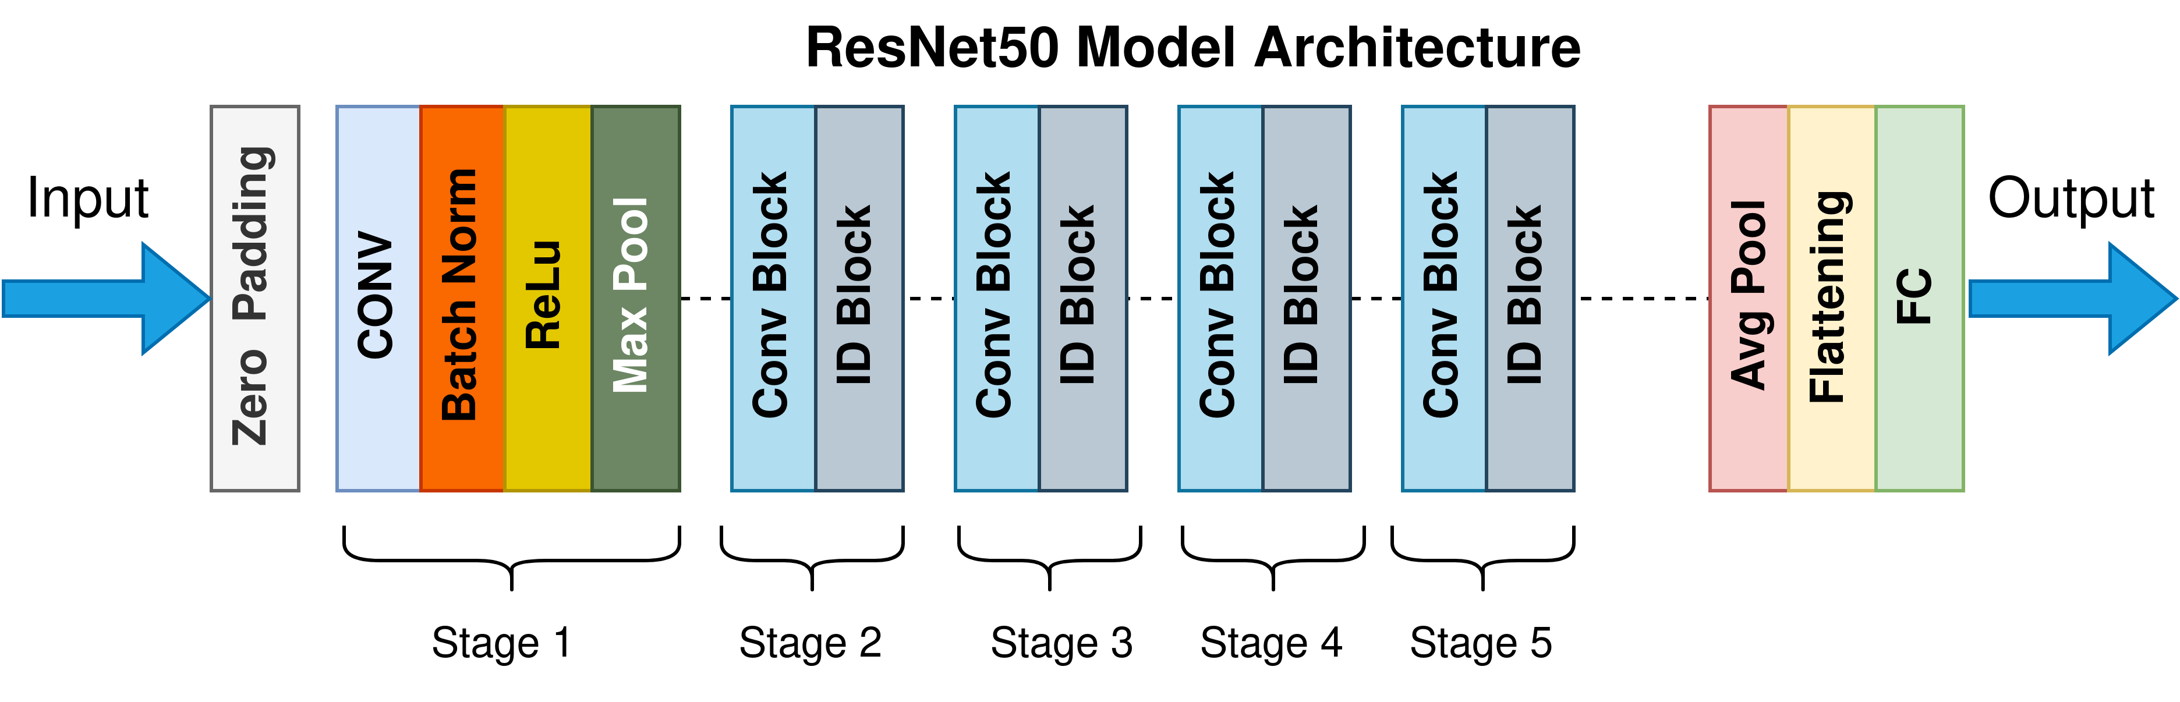
ResNet-50
2.2
Training Methodology
UNIT
02
Introduce
ResNet-50 is CNN architecture that belongs to the ResNet (Residual Networks) family, a series of models designed to address the challenges associated with training deep neural networks
Developed by researchers at Microsoft Research Asia, ResNet-50 is renowned for its depth and efficiency in image classification tasks
ResNet-50 was released in 2015, but remains a notable model in the history of image classification
Facial Age Estimation

Slide 15
ResNet-50
2.2
Training Methodology
UNIT
02
Architecture
The architecture of ResNet-50 consists of 50 layers and uses residual blocks to maintain information across layers
Conv1: A convolutional layer with 64 filters, a 7x7 kernel size, and a stride of 2.
Max Pooling: A max pooling layer with a 3x3 kernel size and a stride of 2.
Conv2x: 3 residual blocks, each block containing 3 convolutional layers (with 64, 64, and 256 filters).
Average Pooling: An average pooling layer
Fully Connected (FC): The final fully connected layer with the number of nodes equal to the number of output classes.
Facial Age Estimation

Slide 16
ResNet-50
2.2
Training Methodology
UNIT
02
Training
Applied transfer learning method by using pre-trained Resnet-50 weight and adjust the linear feature layer
Added a dropout layer which is tunning random neuron weight equal to 0 so that the loss function can effectively adjusts the weight and gives better performance while reducing overfitting.
we only save the best model which means the model with best metric will be saved every epoch
Later, this model can be loaded and used as a checkpoint and continue deeper learning
Facial Age Estimation

Slide 17
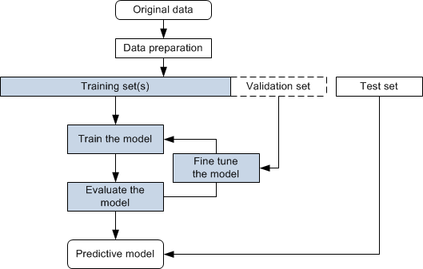
Workflow
2.3
Workflow
UNIT
02
1. Data preprocessing
2. Split Training, Validation, and Test dataset
3. Create data augmentation to increase dataset size and prevent overfitting
4. Design a CNN model inherited from ResNet-50
5. Training process with hyperparameters feed the training dataset
6. Use testing dataset to double-check the accuracy of output model
7. Start over again at training process with different hyperparameters
Facial Age Estimation

Slide 18
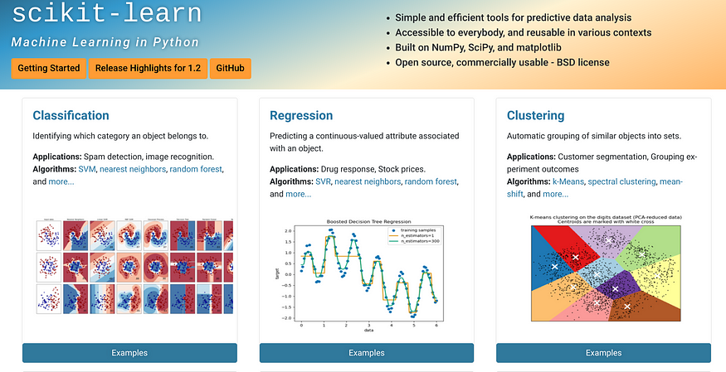
Data preparation
2.4
System Design
UNIT
02
Split training, validation and testing dataset in different 0.68 : 0.12 : 0.2 ratio respectively using built-in function in scikit-learn library.
Facial Age Estimation

Slide 19
Data preparation
2.4
System Design
UNIT
02
Split training, validation and testing dataset in different 0.68 : 0.12 : 0.2 ratio respectively using built-in function in scikit-learn library.
Facial Age Estimation

Slide 20

Model selection
2.4
System Design
UNIT
02
We chose CNN architecture, Resnet-50 specifically. The project will use Python programming language and Pytorch deep learning framework
Facial Age Estimation

Slide 21
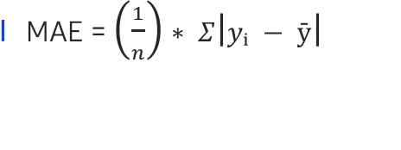
Hyperparameter Tunning
2.4
System Design
UNIT
02
Loss function: Mean Absolute Error (MAE), also known as L1 Loss, is a loss function used in regression tasks that calculates the average absolute differences between predicted values from a machine learning model and the actual target values
MAE = $\left(\frac{1}{n}\right)∗ Σ\left|yᵢ − ȳ\right|$
n is the number of samples in the dataset
yᵢ is the predicted value for the i-th sample
ȳ is the target value for the i-th sample
Facial Age Estimation

Slide 22
Hyperparameter Tunning
2.4
System Design
UNIT
02
Metric : Mean absolute error (synchronize with loss function)
Optimizer: SGD function It is an iterative method for optimizing an objective function with suitable smoothness properties
Batch size: number of input feed into model every step
Epochs: number of times, model learns from dataset
Facial Age Estimation

Slide 23
Testing
2.4
System Design
UNIT
02
Use testing dataset created in data preparation step to test model and plot the diagram.
We will base on that diagram to evaluate the trained model on the validation set to fine-tune model parameters and prevent overfitting.
Finally, testing the real-world data for practical estimation
Facial Age Estimation

Slide 24
Facial Age Estimation
Unit 3. Results
3.1. Data Preprocessing
3.2. Exploratory Data Analysis (EDA)
3.3. Modeling
3.4. User Interface
3.5. Testing and Improvements

Slide 25

Format
3.1
Data Preprocessing
UNIT
03
[age]_[gender]_[race]_[date&time].jpg
[age] is an integer from 0 to 116, indicating the age
[gender] is either 0 (male) or 1 (female)
[race] is an integer from 0 to 4, denoting White, Black, Asian, Indian, and Others (like Hispanic, Latino, Middle Eastern).
[date&time] is in the format of yyyymmddHHMMSSFFF
30_1_2.jpg
Mean Age: 30 Gender: Female Ethnicity: Asian
After matching data with labels, we normalize the tensor image using mean and standard deviation, convert it to a tensor, resize the input images, and perform data augmentation to increase dataset size and reduce overfitting.
Facial Age Estimation

Slide 26
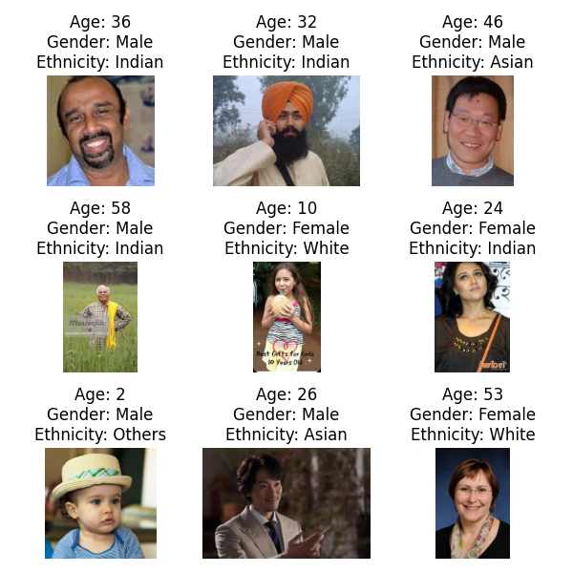
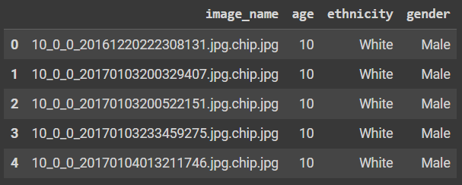
3.2
Exploratory Data Analysis (EDA)
UNIT
03
We used the UTK dataset, which contains images categorized by age, gender, and ethnicity. The process involves plotting sample images and creating a CSV file with basic information, including loading and displaying sample images and obtaining dataset statistics for an overview.
The csv labels include overall information such as age, gender, and ethnicity for each image in the dataset.
Facial Age Estimation

Slide 27
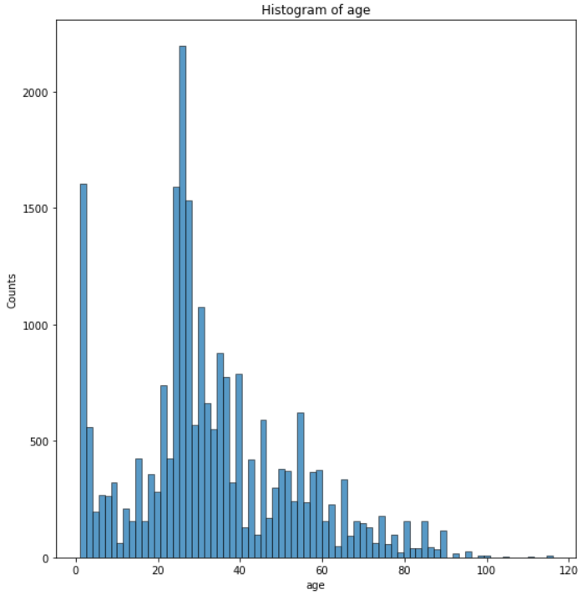
Histogram for Age
3.2
Exploratory Data Analysis (EDA)
03
This is a histogram showing the age distribution in the dataset.
Images at age 25 have the highest quantity, with over 2,000 images, and the average number of images is around 250 for other ages.
Images of individuals over 60 are negligible, leading to significant errors in training the AI.
Facial Age Estimation

Slide 28
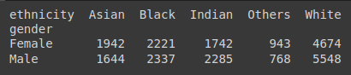
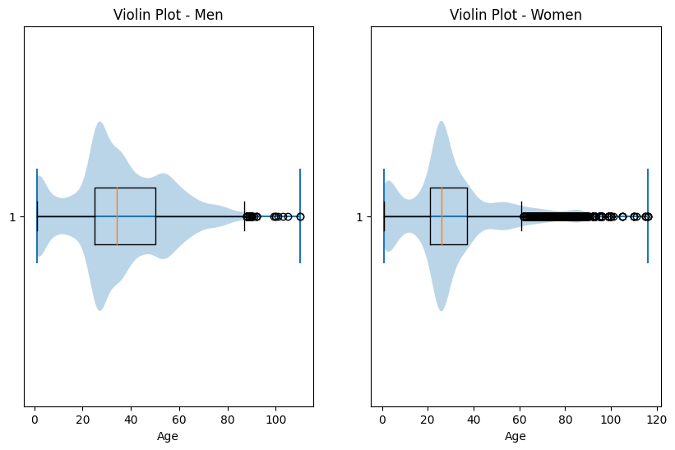
Cross-tabulation of gender and ethnicity
3.2
Exploratory Data Analysis (EDA)
03
Calculating the cross-tabulation of gender and ethnicity using the pandas.crosstab() function.
This analysis can reveal the relationship between gender and ethnicity within the dataset and provide useful insights.
These plots can help identify any differences or patterns in the age distribution between men and women in the UTK dataset.
Facial Age Estimation

Slide 29
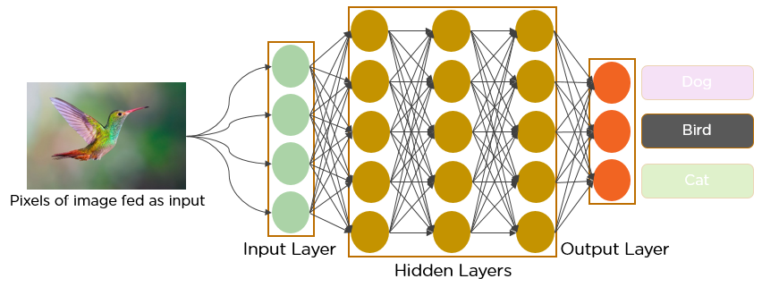
CNN model
3.3
Modeling
03
We chose ResNet-50, a well-known CNN architecture, to achieve the best model. CNNs use deep learning with neural networks and fully connected layers. Neurons, with weights and biases, form the core of this architecture. Weights adjust connections between neurons, while biases add flexibility. The network includes an input layer (image), hidden layers (weight adjustments), and an output layer (result). Convolutional layers extract features and learn patterns, enhancing efficiency in computer vision.
Facial Age Estimation

Slide 30
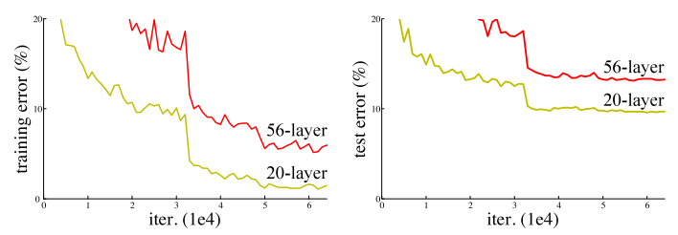
CNN model
3.3
Modeling
03
Deeper networks often face degradation issues, where accuracy saturates and then rapidly degrades, not due to overfitting but due to increasing training error. This problem arises because gradients become very small in deeper layers, leading to ineffective weight updates and gradient vanishing.
Facial Age Estimation

Slide 31
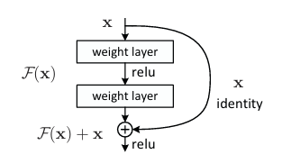
Resnet
3.3
Modeling
03
ResNet, or Residual Network, addresses this by using residual blocks and skip connections, allowing effective training of very deep networks with hundreds of layers. Developed by Kaiming He and his team, ResNet’s architecture overcomes the limitations of deeper networks by facilitating better gradient flow through skip connections.
Facial Age Estimation

Slide 32
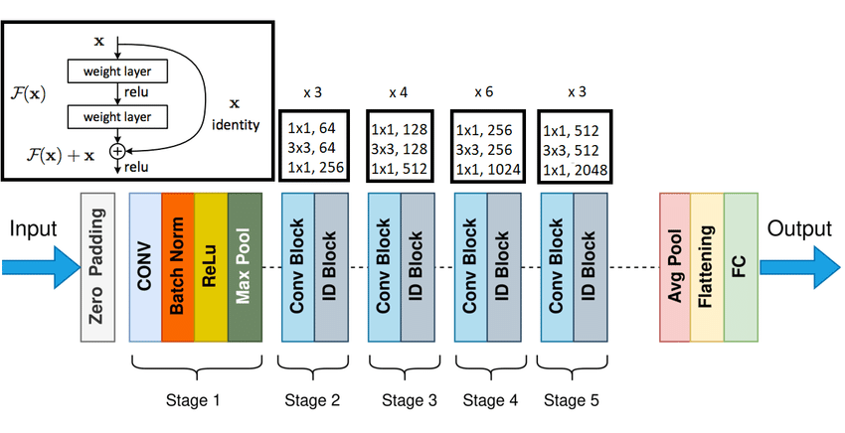
Resnet
3.3
Modeling
03
Each stage of ResNet consists of residual blocks with a linear path and a shortcut connection, which adds the input directly before the ReLU activation. These skip connections help preserve information from earlier layers, improving learning. While ResNet can train networks with up to 152 layers, we use ResNet-50 with 50 layers for this project.
Facial Age Estimation

Slide 33
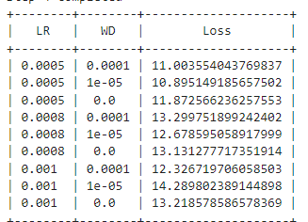
TUNNING
3.3
Modeling
03
Step 1: Calculate the loss for an untrained model using one batch.
Step 2: Train and overfit the model on a small subset of the dataset.
Step 3: Train the model for a limited number of epochs, experimenting with various learning rates.
Step 4: Create a small grid using weight decay and the best learning rate and save it to a CSV file.
Step 5: Train the model for longer epochs using the best model from step 4. .
Step 6: Save the best model from .pt to .jit.
Facial Age Estimation

Slide 34
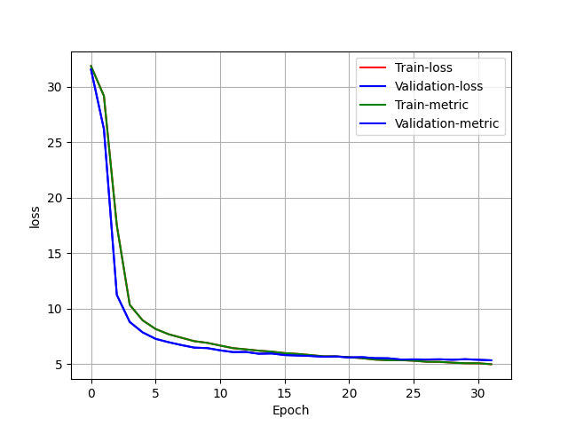
Train and Evaluation Loop
3.3
Modeling
03
The train loop handles the training process, including forward and backward passes, updating model parameters, and monitoring training metrics. The evaluation loop performs model evaluation on a separate validation or test dataset and computes relevant evaluation metrics.
Facial Age Estimation

Slide 35
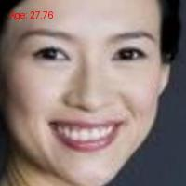
Plotting Learning Curves with Matplotlib and TensorBoard
3.4
Testing and Improvements
03
Learning curves show the model's training and validation performance over epochs, helping to identify learning progress, convergence, and issues like overfitting or underfitting.
TensorBoard is a tool for tracking and visualizing metrics like loss and accuracy, viewing the model graph, and projecting embeddings, aiding in the machine learning workflow.
The final model shows promising results with a low loss (~5) at epoch 31. For example, the predicted age was 27.76, while the actual age was 30, resulting in a loss of 2.24. Perceptions of age can vary due to factors like aging, skin health, lighting, and emotions. Despite these challenges, this is our best model to date. Further improvements are discussed in Section 3.5.
Facial Age Estimation

Slide 36
Testing and Improvements
3.4
Testing and Improvements
03
Resnet-50 with 2 linear layers, 128 x 128 image (primary model)
Facial Age Estimation

Slide 37
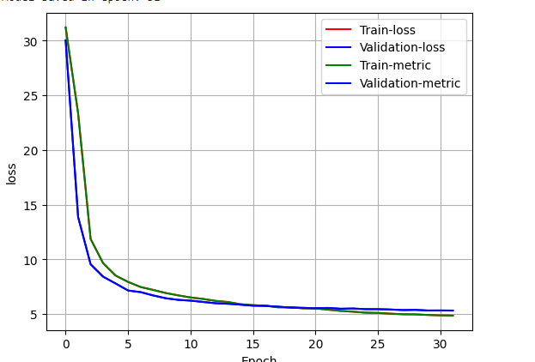
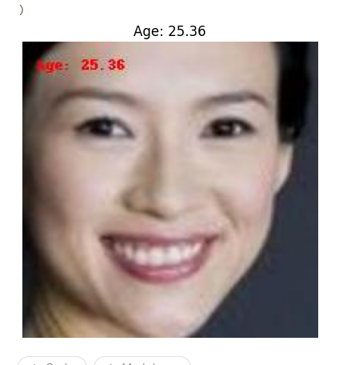
Testing and Improvements
3.4
Testing and Improvements
03
Resnet152 with 2 linear layers, 128 x 128 image
Facial Age Estimation

Slide 38
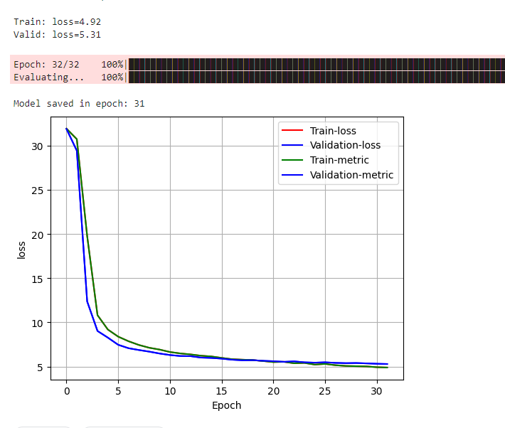
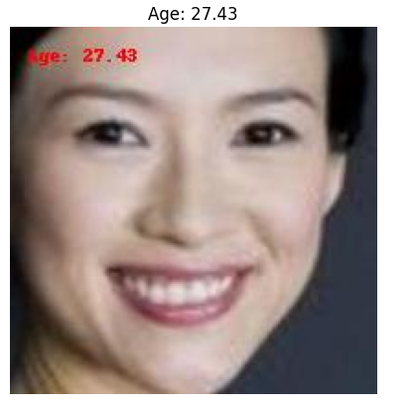
Testing and Improvements
3.4
Testing and Improvements
03
Resnet125 with 4 linear layers, 128 x 128 image
Facial Age Estimation

Slide 39
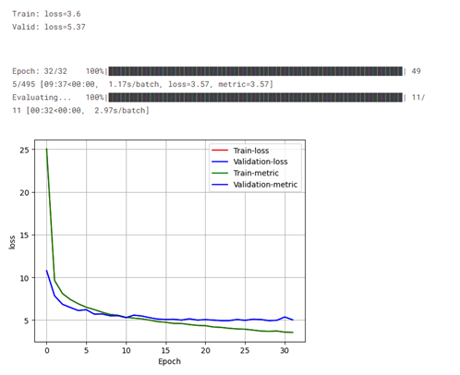
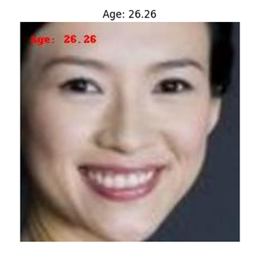
Testing and Improvements
3.4
Testing and Improvements
03
Resnet152 with 4 linear layer, 256 x 256 image
Facial Age Estimation

Slide 40
Facial Age Estimation
Unit 4. Projected Impact
4.1. Accomplishments and Benefits
4.2. Future Improvements

Slide 41
Accomplishments
4.1
Accomplishments and Benefits
UNIT
04
The model performed relatively well in its designed task with decent prediction result compare to its scale. The loss is quite low and the outcome is not significantly different from the reality.
Facial Age Estimation

Slide 42

Benefits
4.1
Accomplishments and Benefits
04
Protecting children from harmful or inappropriate content ensures their safety and mental well-being online.
Facial Age Estimation

Slide 43

Benefits
4.1
Accomplishments and Benefits
04
Streaming services like Netflix or Amazon Prime can use age estimation to recommend content suitable for the viewer’s age.
Facial Age Estimation

Slide 44
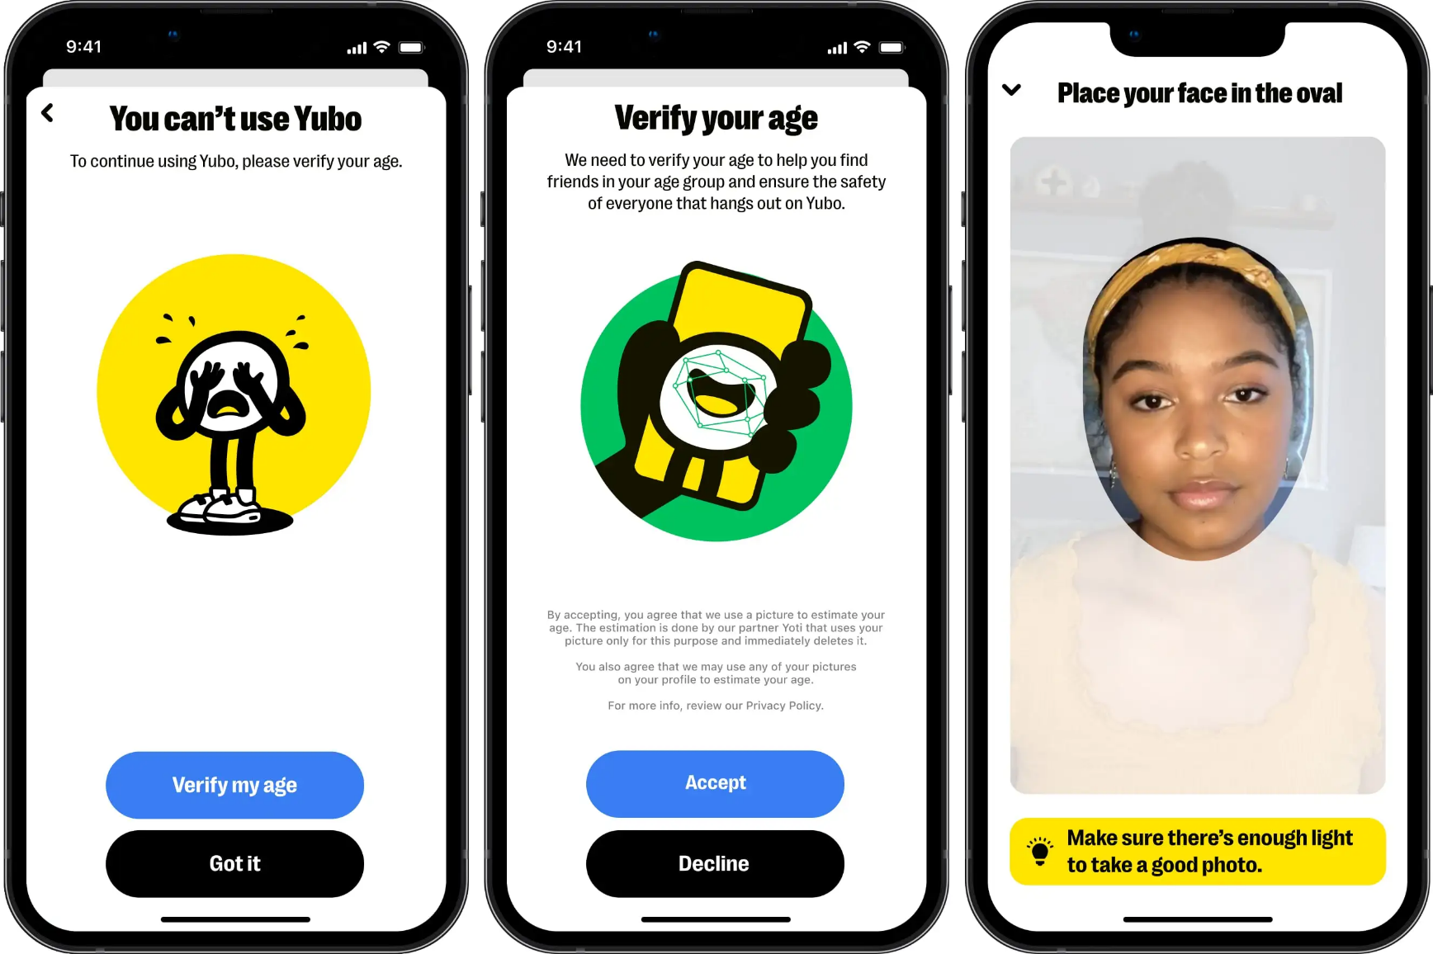
Benefits
4.1
Accomplishments and Benefits
04
Websites with adult content can use facial age estimation to verify a user’s age in real-time. If a user appears to be underage, the site can block access to adult content.
Facial Age Estimation

Slide 45
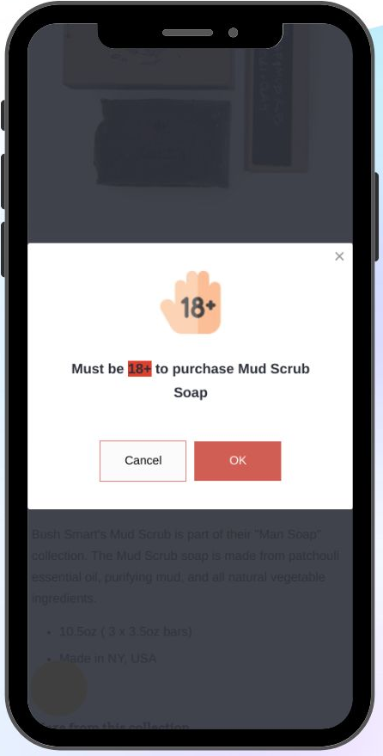

Benefits
4.1
Accomplishments and Benefits
04
Age estimation can be used to restrict in-game purchases or microtransactions that may not be appropriate for children.
Facial Age Estimation

Slide 46
Future Improvements
4.2
Future Improvements
04
There are many aspects can be improved. We can add a early stop function to stop the training process if the model’s metric doesn’t improve.
If the hardware problem was solved, we could using entire UTKFace dataset instead of using crop vesion.
Using other morden architecture is a interesting approach. We are thinking about using morden vision transformer (ViT) architecture after this project. Because of that, in our source code, you can find ViT and EfficientNet B0 in model.py.
Adding another feature is also a viable option. Our model not only estimate the age but also ethic and gender. Later, this model can be used in ecconomy or marketing service to assist companies give the best service and product to appropriate custom.
Facial Age Estimation

